Slide 1
CS595—Big Data Technologies
Module 10
High Velocity Data Processing
Apache Spark Streaming

Slide 2
The Need for Streaming Big Data Processing
Data is being created at unprecedented rates
Exponential data growth from mobile, web, social
Connected devices: 9B in 2012 to 50B by 2020
Over 1 trillion sensors by 2020
Datacenter IP traffic growing at 25% annually
How can we harness this data in real-time?
Value can quickly degrade → capture value immediately
From reactive analysis to direct operational impact
Unlocks new competitive advantages
Requires a completely new approach...

Slide 3
From Volume and Variety to Velocity
Big Data has evolved
Past
Big-Data = Volume + Variety
Present
Big-Data = Volume + Variety + Velocity
Hadoop Ecosystem evolves as well…
Past
Present
Batch Processing
Time to insight of Hours
Batch + Stream Processing
Time to Insight of Seconds
Notes:
The Narrative:
As you can see from the previous slides, lots of streaming data will be generated. Making this data actionable in real time is very valuable across industries.
Our very own Hadoop is all you need.
Previously Hadoop was associated just with “big unstructured data”. That was hadoop’s selling point.
But now, Hadoop can also handle real-time data (in addition to big unstructured). So think Hadoop when you think Real-Time Streaming.
Purpose of the slide:
Goal is to associate Hadoop with real-time……to get people to think hadoop when they think real-time streaming data.

Slide 4
Streaming System Requirements
Scalable to large clusters
Second-scale latencies
Simple programming model
Integrated with batch & interactive processing
Efficient fault-tolerance in stateful computations

Slide 5
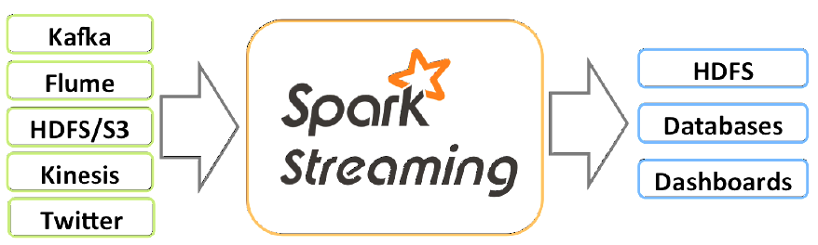
Spark Streaming
Spark Streaming is an extension of the core Spark API that enables scalable high-throughput, fault-tolerant stream processing of live data streams

Slide 6
Spark Streaming
Framework for large scale stream processing
A layer over the core Spark API
Scales to 100s of nodes
Can achieve second scale latencies
Integrates with Spark’s batch and interactive (SQL) processing
Provides a batch-like API for implementing complex algorithms

Slide 7
Spark Streaming
Can be processed using high-level functions like map, reduce, join and window
Can also apply Spark’s machine learning and graph processing algorithms on data streams
Can absorb live data streams from Kafka, Flume, etc.
Can push processed data out to filesystems, databases, and live dashboards

Slide 8
From Kafka to Spark Streaming
Kafka is sometimes called a stream processing system
But until streaming capability was recently added to Kafka it is better described as a message processing system
So what is stream processing and how is it different from what Kafka offers
Kafka accepts messages from producers and passes them on to consumers with little if any modification
It performs no analysis or data transformation to the messages that it handles
But this is exactly the purpose and function of stream processing systems

Slide 9






Key Components of Streaming In Hadoop
Data Ingestion
& Transportation
Service
Real-Time Stream
Processing Engine
Real-Time
Data Serving
Kafka
Flume
Security
System Management
Data Management & Integration

Slide 10




Canonical Hadoop Stream Processing Architecture
Data Sources
HDFS
HBase
Data Ingestion
Kafka
Flume
App 1
Kafka
App 2
.
.
.

Slide 11
How Does Spark Streaming Work? Discretized Stream Processing
Run a streaming computation as a series of very small, deterministic batch jobs
Chop up the live stream into batches of X seconds
Spark treats each batch of data as RDDs and processes them using RDD operations
Finally, the processed results of the RDD operations are returned in batches
live data stream
Spark
Streaming
batches of X seconds
Spark
processed results

Slide 12
How Does Spark Streaming Work? Discretized Stream Processing
Use the core Spark engine to execute these batch jobs through optimized parallel and in memory processing
live data stream
Spark
Streaming
Batch sizes as low as ½ second, latency of about 1 second
Potential for combining batch processing and streaming processing in the same system
batches of X seconds
Spark
processed results

Slide 13
Spark Streaming Key Concepts
DStream – sequence of RDDs representing a stream of data
Twitter, HDFS, Kafka, Flume, ZeroMQ, Akka Actor, TCP sockets
Transformations – modify data from on DStream to another
Standard RDD operations – map, countByValue, reduce, join, …
Stateful operations – window, countByValueAndWindow, …

Slide 14
Spark Streaming Key Concepts
Output Operations – send data to external entity
saveAsHadoopFiles – saves to HDFS
foreachRDD – do anything with each batch of results

Slide 15
RDDs
RDD = Resilient Distributed Datasets
Immutable representation of data
Operations on one RDD creates a new one
Memory caching layer that stores data in a distributed, fault-tolerant cache
Created by parallel transformations on data in stable storage
Lazy materialization
Two observations:
Can fall back to disk when data-set does not fit in memory
Provides fault-tolerance through concept of lineage

Slide 16
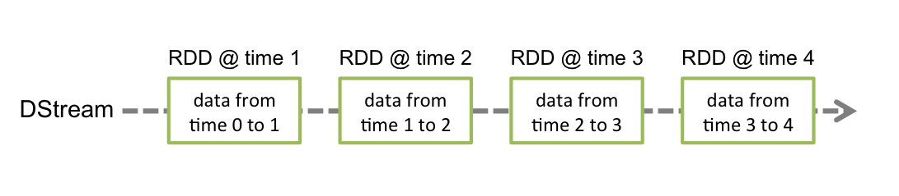
Discretized Streams (DStreams)
DStream is the basic abstraction provided by Spark Streaming
It represents a continuous stream of data, either the input data stream received from source…
Or the processed data stream generated by transforming the input stream
Internally, a DStream is represented by a continuous series of RDDs, which is Spark’s abstraction of an immutable, distributed dataset
Each RDD in a DStream contains data from a certain interval…

Slide 17
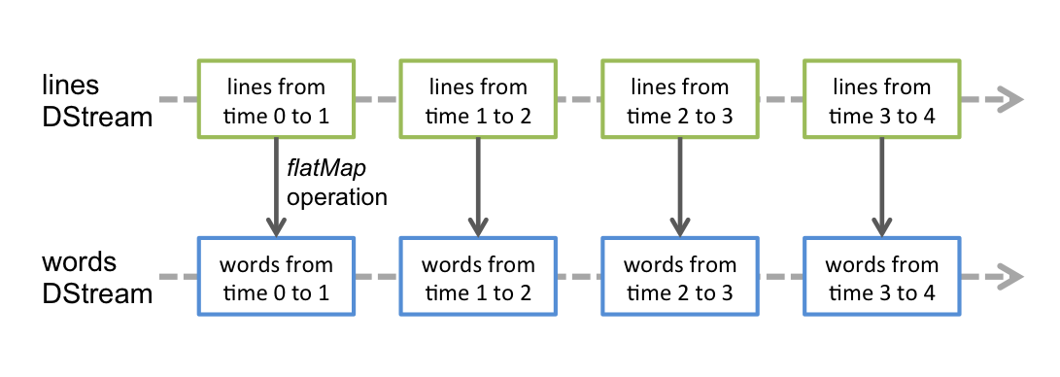
Discretized Streams (DStreams)
Any operation applied on a DStream translates to operations on the underlying RDDs
In the upcoming example of converting a stream of lines to words…
A flatMap operation well be applied to each RDD in the lines DStream to generate RDDs of the words DStream…

Slide 18
Discretized Streams (DStreams)
These underlying RDD transformations are computed by the Spark engine
The DStream operations hide most details and provides the developer with a higher-level API for convenience

Slide 19
DStream Input Sources
Out of the box Spark Streaming provides receivers for…
Kafka
HDFS
Flume
Raw TCP sockets
Some others
Other receivers can be found on the web
Easy to write a custom receiver your source

Slide 20
Spark Streaming Programming Model
Discretized Stream (DStream)
Represents a stream of data
Implemented as a sequence of RDDs
DStreams API very similar to RDD API
Functional APIs in Scala, Java, Python (limited)
Create input DStreams from different sources
Apply parallel operations

Slide 21
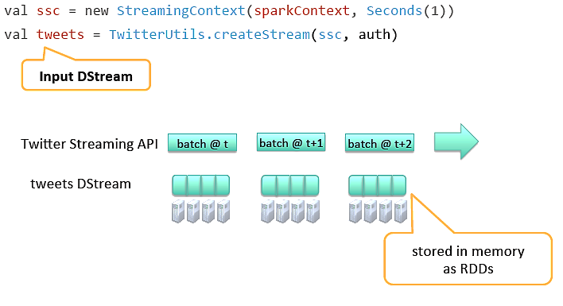
Example – Get Hashtags from Twitter

Slide 22
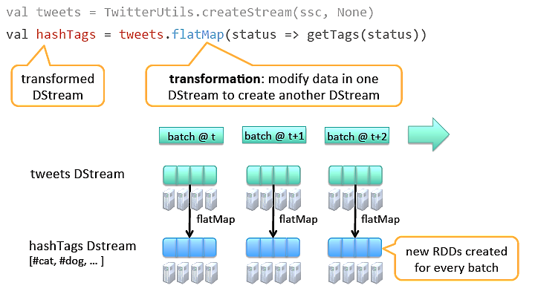
Example – Get Hashtags from Twitter

Slide 23
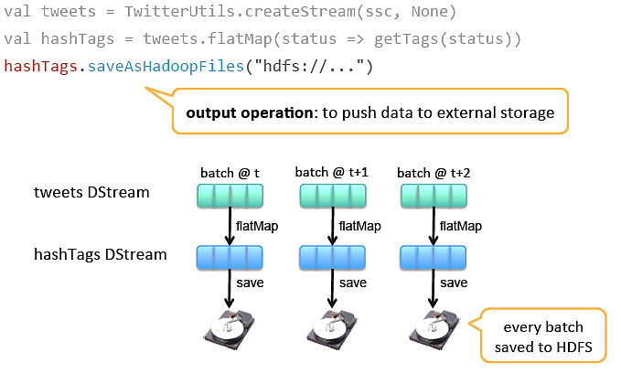
Example – Get Hashtags from Twitter

Slide 24
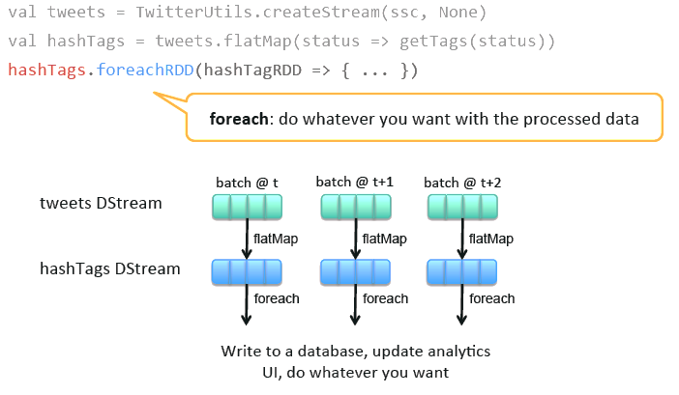
Example – Get Hashtags from Twitter

Slide 25

Fault Tolerance: Worker
RDDs remember the operations that created them
Batches of input data are replicated in memory for fault-tolerance
Data lost due to worker failure, can be recomputed from replicated input data
All transformed data is fault-tolerant, and exactly-once transformations
tweets
RDD
input data replicated
in memory
flatMap
hashTags
RDD
lost partitions recomputed on other workers

Slide 26
Fault Tolerance: Master
Spark Master saves the state of the DStreams to a checkpoint file
Checkpoint file are saved to HDFS periodically
If master fails, it can be restarted using the checkpoint file

Slide 27
Example – Word Count
Let’s take a quick look at what a streaming word count program looks like
Here we want to count the number of words in a stream of text data received by listening on a TCP socket…

Slide 28
Example – Word Count
First, we import StreamingContext, which is the main entry point for all streaming functionality
We create a local StreamingContext with two execution threads, and batch interval of 1 second
from pyspark import SparkContext
from pyspark.streaming import StreamingContext
# Create a local StreamingContext with two working thread # and batch interval of 1 second
sc = SparkContext("local[2]", "NetworkWordCount")
ssc = StreamingContext(sc, 1)

Slide 29
Example – Word Count
Using this context, we can create a DStream that represents streaming data from a TCP source…
Specified as hostname (e.g. localhost) and port (e.g. 9999)
# Create a DStream that will connect to hostname:port, like # localhost:9999
lines = ssc.socketTextStream("localhost", 9999)

Slide 30
Example – Word Count
The “lines” DStream represents the stream of data that will be received from the data server
Each record in the “lines” DStream is a line of text
Now we want to split the lines by space into words
# Split each line into words
words = lines.flatMap(lambda line: line.split(" "))
flatMap is a one-to-many DStream operation that creates a new Dstream…
By generating multiple new records from each record in the source Dstream
Each line will be split into multiple words and the stream of words is represented as the “words” Dstream.

Slide 31
Example – Word Count
Next we want to count these words…
# Count each word in each batch
pairs = words.map(lambda word: (word, 1))
wordCounts = pairs.reduceByKey(lambda x, y: x + y)
The words DStream is further mapped (one-to-one transformation) to a DStream of (word, 1) pairs…
Which is then reduced to get the frequency of words in each batch of data

Slide 32
Example – Word Count
Finally, wordCounts.pprint() will print a few of the counts generated every second
# Print the first ten elements of each RDD generated in this
# DStream to the console
wordCounts.pprint()

Slide 33
Example – Word Count
Note that when the above lines are executed, Spark Streaming only sets up the computation it will perform
To start the processing after all the transformations have been setup, we finally call
ssc.start() # Start the computation
ssc.awaitTermination() # Wait for the computation to terminate

Slide 34
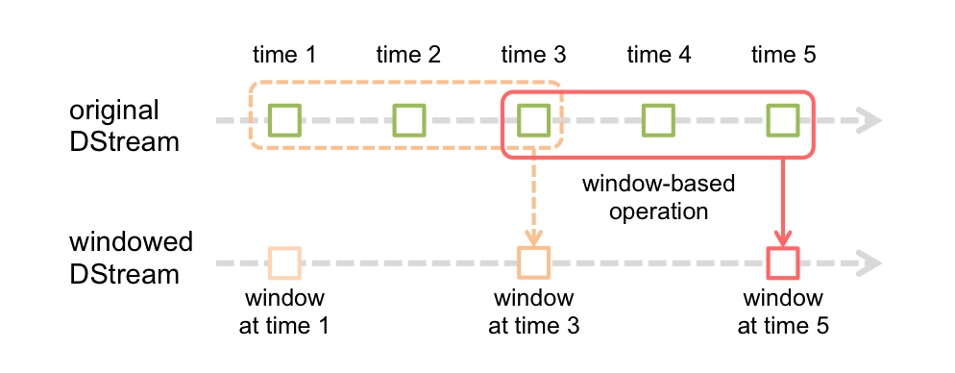
Window Operations
Spark Streaming also provides windowed computations
These allow you to apply transformations over a sliding window of data

Slide 35
Window Operations
Every time the window slides over a source DStream, the source RDDs that fall within the window are combined and operated upon to produce the RDDs of the windowed Dstream
In this specific case, the operation is applied over the last 3 time units of data, and slides by 2 time units
This shows that any window operation needs to specify two parameters.
window length - The duration of the window (3 in the figure)
sliding interval - The interval at which the window operation is performed (2 in the figure)

Slide 36
Example – Count Hashtags over last 10 mins
val tweets = ssc.twitterStream()
val hashTags = tweets.flatMap (status => getTags(status))
val tagCounts = hashTags.window(Minutes(1), Seconds(5)).countByValue()
sliding window operation
window length
sliding interval
window length
DStream of data
sliding interval

Slide 37
Example – Count Hashtags over last 10 mins
val tagCounts = hashTags.window(Minutes(10), Seconds(1)).countByValue()
t-1
t
t+1
t+2
t+3
hashTags
sliding window
countByValue
count over all the data in the window
tagCounts

Slide 38
Other Interesting Operations
Maintaining arbitrary state, track sessions
Maintain per-user mood as state, and update it with his/her tweets
tweets.updateStateByKey(tweet => updateMood(tweet))
Do arbitrary Spark RDD computation within DStream
Join incoming tweets with a spam file to filter out bad tweets
tweets.transform(tweetsRDD => {
tweetsRDD.join(spamHDFSFile).filter(...)
})

Slide 39
Integration with Batch Processing
Many environments require processing same data in live streaming as well as batch post processing
Recall the Lambda architecture
Some frameworks cannot do both
Either do stream processing of 100s of MB/s with low latency
Or do batch processing of TBs / PBs of data with high latency
Extremely painful to maintain two different stacks
Different programming models
Double the implementation effort
Double the number of bugs
Complicates implementation of the Lambda architecture

Slide 40
Vision - One Stack to Rule Them All
Ad-hoc Queries
Batch Processing
Stream Processing
Spark
+
Spark
Streaming
+
Spark SQL

Slide 41
Vision - One Stack to Rule Them All
Explore data interactively using Spark Shell to identify problems
Use same code in Spark stand-alone programs to identify problems in production logs
Use similar code in Spark Streaming to identify problems in live log streams
$ ./spark-shell
scala> val file = sc.hadoopFile(“smallLogs”)
...
scala> val filtered = file.filter(_.contains(“ERROR”))
...
scala> val mapped = file.map(...)
...
object ProcessProductionData {
def main(args: Array[String]) {
val sc = new SparkContext(...)
val file = sc.hadoopFile(“productionLogs”)
val filtered = file.filter(_.contains(“ERROR”))
val mapped = file.map(...)
...
}
}
object ProcessLiveStream {
def main(args: Array[String]) {
val sc = new StreamingContext(...)
val stream = sc.kafkaStream(...)
val filtered = file.filter(_.contains(“ERROR”))
val mapped = file.map(...)
...
}
}

Slide 42
Spark vs Spark Streaming
Spark Streaming program on Twitter stream
val tweets = ssc.twitterStream(<Twitter username>, <Twitter password>)
val hashTags = tweets.flatMap (status => getTags(status))
hashTags.saveAsHadoopFiles("hdfs://...")
Spark program on Twitter log file
val tweets = sc.hadoopFile("hdfs://...")
val hashTags = tweets.flatMap (status => getTags(status))
hashTags.saveAsHadoopFile("hdfs://...")

Slide 43
Sharing Code between Batch and Streaming
Streaming generates RDDs periodically
Any code that operates on RDDs can therefore be used in streaming as well
Library that filters “ERRORS”
def filterErrors (rdd: RDD[String]): RDD[String] = {
rdd.filter(s => s.contains(“ERROR”))
}

Slide 44
Sharing Code between Batch and Streaming
Spark:
val lines = sc.textFile(…)
val filtered = filterErrors(lines)
filtered.saveAsTextFile(...)
Spark Streaming:
val dStream = FlumeUtils.createStream(ssc, "34.23.46.22", 4435)
val filtered = dStream.foreachRDD((rdd: RDD[String], time: Time) => {
filterErrors(rdd)
}))
filtered.saveAsTextFiles(…)

Slide 45
Comparison with Apache Storm
Higher throughput than Storm
Spark Streaming: 670k records/second/node
Storm: 115k records/second/node
Notes:
Streaming Spark offers similar speed while providing FT and consistency guarantees that these systems lack

Slide 46
Transformations on DStreams
Similar to that of RDDs, transformations allow the data from the input DStream to be modified
DStreams support many of the transformations available on normal Spark RDD’s

Slide 47
Dstream Transformations
Transformation | Meaning
map(func) | Return a new DStream by passing each element of the source DStream through a function func.
flatMap(func) | Similar to map, but each input item can be mapped to 0 or more output items.
filter(func) | Return a new DStream by selecting only the records of the source DStream on which func returns true.
repartition(numPartitions) | Changes the level of parallelism in this DStream by creating more or fewer partitions.
union(otherStream) | Return a new DStream that contains the union of the elements in the source DStream and otherDStream.

Slide 48
Dstream Transformations
Transformation | Meaning
count() | Return a new DStream of single-element RDDs by counting the number of elements in each RDD of the source DStream.
reduce(func) | Return a new DStream of single-element RDDs by aggregating the elements in each RDD of the source DStream using a function func (which takes two arguments and returns one). The function should be associative and commutative so that it can be computed in parallel.
countByValue() | When called on a DStream of elements of type K, return a new DStream of (K, Long) pairs where the value of each key is its frequency in each RDD of the source DStream.

Slide 49
Dstream Transformations
Transformation | Meaning
reduceByKey(func, [numTasks]) | When called on a DStream of (K, V) pairs, return a new DStream of (K, V) pairs where the values for each key are aggregated using the given reduce function.
join(otherStream, [numTasks]) | When called on two DStreams of (K, V) and (K, W) pairs, return a new DStream of (K, (V, W)) pairs with all pairs of elements for each key.
cogroup(otherStream, [numTasks]) | When called on a DStream of (K, V) and (K, W) pairs, return a new DStream of (K, Seq[V], Seq[W]) tuples.

Slide 50
Dstream Transformations
Transformation | Meaning
transform(func) | Return a new DStream by applying a RDD-to-RDD function to every RDD of the source DStream. This can be used to do arbitrary RDD operations on the DStream.
updateStateByKey(func) | Return a new "state" DStream where the state for each key is updated by applying the given function on the previous state of the key and the new values for the key. This can be used to maintain arbitrary state data for each key.

Slide 51
Output Operations on DStreams
Output operations allow DStream’s data to be pushed out to external systems like a database or a file systems
Since the output operations actually allow the transformed data to be consumed by external systems, they trigger the actual execution of all the DStream transformations
Some examples…
Output Operation | Meaning
print() | Prints the first ten elements of every batch of data in a DStream on the driver node running the streaming application. This is useful for development and debugging. This is called pprint() in the Python API.
saveAsTextFiles(prefix, [suffix]) | Save this DStream's contents as text files. The file name at each batch interval is generated based on prefix and suffix: "prefix-TIME_IN_MS[.suffix]".

